Slide 1
Foundations of Test Automation
Yury Makedonov, IVM-S
Version 1.07.
Yury Makedonov,
(416) 481-8685
yury@ivm-s.com
http://www.softwaretestconsulting.com
© Copyright 2006 – Yury Makedonov

Slide 2
Introduction of a workshop
1 – Introduction of a workshop

Slide 3
Target audience
This workshop is for everybody who is involved in GUI test automation performed by an independent testing team:
  GUI test automation specialists
  Functional testers
  Managers of GUI test automation teams
  Managers of functional test teams
Note: Developers and their managers although would benefit from this workshop although they are not a target audience.
Notes:
Audience expectations:
Details of students projects
Details of students experience
Students' expectations

Slide 4
Outline
Introduction
GUI structure and properties
Using scripting languages WSH/Perl/Ruby for testing
WATIR
Introduction of commercial GUI testing tools
Major test automation approaches/frameworks
  Record and replay
  Functional decomposition
  Data driving
  Action driven/keyword driven frameworks
FIT/FITnesse
Test automation process
Managing GUI test automation

Slide 5
Developers Testing vs.
Independent Testing
Developers Testing:
  Low level atomic Unit Test Cases
  Typically GUI-less
  Automation of Unit Test Cases is done by developers
  Unit Testing is outside of scope of this workshop
Independent Functional/System Testing:
  Typically GUI based tests
  Testing is performed typically by an independent testing team
  Automation is performed by functional testers or devoted test automation specialists
  This is a focus of today's workshop

Slide 6
Automated Testing vs.
Regression Test Automation
“Automated testing” = testing by a computer;
In this case the design of a test procedure and identification of expected results are being performed by a computer.
  “Dumb Monkey” for Rational Visual Test
This workshop is mainly about:
“Regression GUI test automation”
“Regression GUI test automation” = automation of the execution of manual functional test cases which were developed and documented by a human
Functional test cases typically have to be created before the start of GUI test automation.

Slide 7

Scope of Test Automation

Slide 8
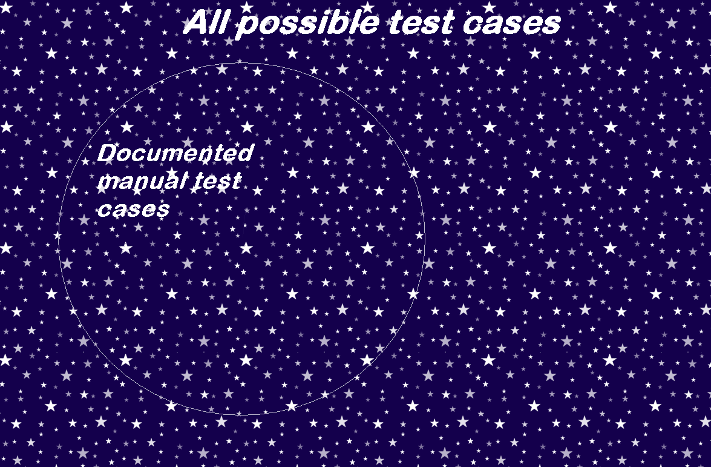
Scope of Test Automation

Slide 9
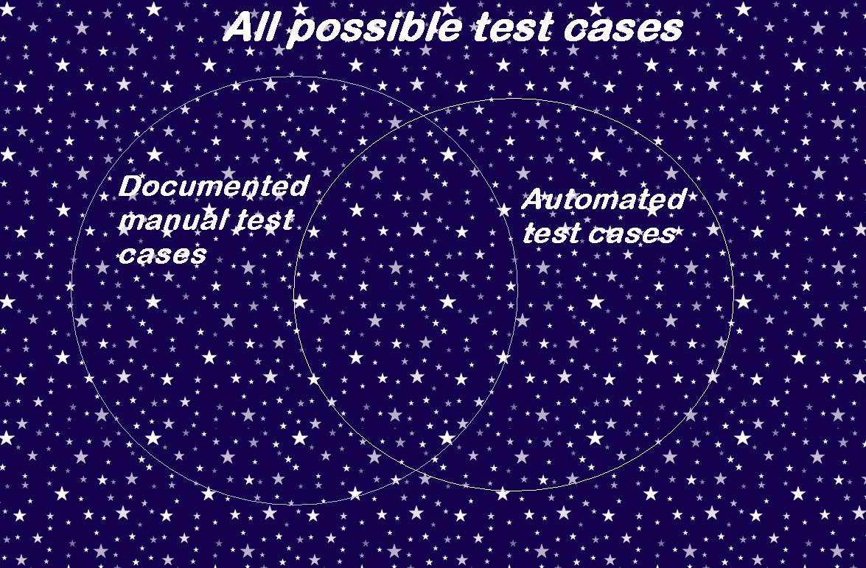
Scope of Test Automation

Slide 10
Different approaches to GUI Test Automation
Different approaches to GUI Test Automation:
  Scripting languages WSH/Perl/Ruby
  WATIR
  Commercial GUI Testing Tools
  FIT/FITnesse

Slide 11
Using scripting languages for GUI Test Automation
2 – Using scripting languages
for GUI Test Automation

Slide 12
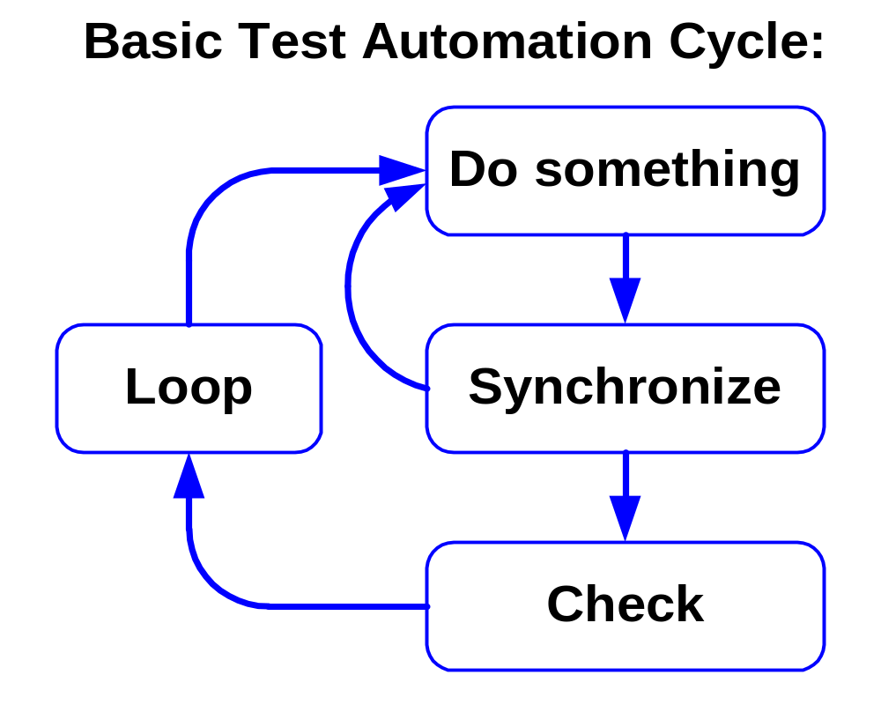
Basic Test Automation Cycle

Slide 13
Scripting languages VBS, Perl, Ruby, etc.
Everything should be coded manually
(No recording capability)
Sample Perl code (with Win32::GuiTest module):
  Key pressing:
  SendKeys("O");
  SendKeys("{RIGHT}");
  Finding text in an Application:
  $text = GetWindowText($window);
  $text = WMGetText($window);
This approach typically is used for small scale automation by a developer

Slide 14
WATIR
WATIR – "Web Application Testing in Ruby"
WATIR is a Ruby library
WATIR works with Internet Explorer on Windows.
Sample WATIR code:
  test_site = 'http://www.google.com' #variable defined
  ie = IE.new #opens the IE browser
  ie.goto(test_site) #opens Google web site
  # Enter "pickaxe" into a search field 'q':
  ie.text_field(:name, "q").set("pickaxe")
  ie.button(:name, "btnG").click #"btnG" - 'Search' button
WATIR is better for a serious test automation than Ruby itself. It's popular among agile teams.

Slide 15
IBM Rational Visual Test
No recording capabilities
Everything has to be coded manually
Sample functional script:
  Start Notepad
  Display the Open dialog box,
  Enter a file name, and
  Open that file into the Notepad application
Visual Test code:
  run "notepad.exe",nowait
  wMenuSelect("File\Open")
  wEditSetText("File name:","bootlog.txt")
  wButtonClick("Open")
  END
  It’s a museum relic!

Slide 16
Commercial GUI testing tools
3 – Commercial GUI testing tools

Slide 17
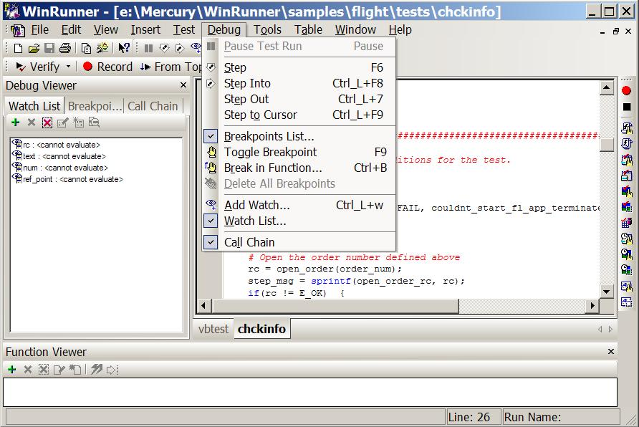
GUI test automation tool – an example

Slide 18
Record and Replay Tools
Record and replay tools:
Tester executes manual test script while GUI testing tool records all his actions:
  Mouse clicks
  Key presses
  Pauses/delays
Then GUI testing tool replays the script exactly as it was recorded, including:
  Timing of script execution
  Data entered into different fields

Slide 19
GUI Testing Tools to be discussed
The most efficient GUI test automation tools are the ones from major vendors:
  Mercury WinRunner and QuickTest Pro,
  Segue Silk,
  Compuware QARun,
  IBM Rational Robot,
  etc.
These tools are typically used by independent testing teams to automate functional test cases.

Slide 20
Myth #1 – Commercial GUI testing tools are expensive.
Under the influence of this myth some people:
  try to develop their own testing tools to save money,
  use scripting languages like Perl and Ruby to automate functional test cases and
  do not consider test automation at all.
GUI testing tools are indeed much more expensive than such development tools as Microsoft Visual Studio or Borland JBuilder,
But are they really expensive?
High prices of GUI testing tools are just a myth!

Slide 21

Reality – GUI testing tools are cheap
Per seat license for one of the most expensive GUI testing tools is about $8,000.00.
This tool will be used for two years
(and then thrown away or put on a shelf).
Cost of this tool is $4,000.00 per year.
Cost of test automation person with overhead is $80,000.00 per year.
The cost of a GUI testing tool is just 5% of the cost of the person who will use it.
The increase of productivity of a person who uses these tools is more than 5% compared to a person who uses other alternatives.

Slide 22
GUI test automation approaches
4 – GUI test automation frameworks

Slide 23
Record and Replay test automation – Pros
The record and replay approach is relatively simple and fast
The record and replay approach might be useful when you change something beyond GUI, e.g.:
  Back-end configuration parameters,
  Back end OS,
  Version of back-end product
  etc.,

Slide 24
Record and Replay test automation – example
Example of successful implementation:
  Verification that online bill looks exactly the same after a new version of a back end Bill Presentment system is implemented.
Billers were extremely sensitive about the exact appearance of their bills:
  Corporate logos should be valid up to a pixel,
  The layout of an electronic bill should be pretty close to the paper version; it should be exactly the same regardless of all changes to the back end code.
The same user IDs, account numbers and bill amounts were used for every test run.

Slide 25
Record and Replay test automation – Cons
Only one functional test case can be automated by one automated test script.
What about changes in:
  GUI
  Target URL,
  User ID/Password
  Business data (e.g. price, order number, invoice number, posting date, etc.)?
When anything changes (new version of a product, new build, bug fixes, patches, test data, etc.) – the script has to be rerecorded!
Poor maintainability
Very limited usefulness

Slide 26
Record and Replay test automation – conclusion
The success story I described above (verification of online bills) might be only an exception.
Applicability/utility of “record and replay” approach is very limited.
Typically I recommend it only for training purposes
(when learning these tools).

Slide 27
Test automation approaches / frameworks:
Functional Decomposition – a challenge
Let’s assume that you have 27 scripts.
Each script starts with the same statement:
web_browser_invoke(IE, http://confut.cell.ca);
You need to execute these scripts against different
environments, e.g. QA, Mirror, Staging
What would you do with a “classical” record and replay approach?
You develop a script for every target URL, e.g.:
  Verify_Access_QA,
  Verify_Access_Staging,
  Verify_Access_Mirror
The only difference between them – the initial URL!
We have uncontrolled multiplication of test scripts!

Slide 28
Test automation approaches / frameworks:
Functional Decomposition – an example
We start with the recorded script
Then we introduce functions
We remove this statement from all scripts:
web_browser_invoke(IE,http://confut.cell.ca);
And substitute it with a function:
UT_Site_Open();
This function is described only in one place.
When we need to execute these 27 scripts against another environment all we have to do is change the code in just one place!

Slide 29
Test automation approaches / frameworks:
Functional Decomposition – sample code
Main test script:
. . . . . . . . . . . . . . . . . . . . . .
load("Lib_UT_Functions");
UT_Site_Open( );
UT_Select_Language("English");
UT_Login("a327012", "12345");
. . . . . . . . . . . . . . . . . . . . . .
____________________________________________________
Function:
function UT_Site_Open( )
{
#Opens a new UT site in a new browser window:
web_browser_invoke(IE, http://confut.cell.ca);
return 0;
}

Slide 30
Functional Decomposition – pros
We can use a “Functional decomposition” approach when:
  Different test scripts include identical actions (groups of test steps) e.g. “Login”.
We substitute these repetitive groups in all scripts with functions.
When script is broken due to any change of GUI or business logic we have to modify script code only in one place.
Pros: High Maintainability
The functional decomposition method could be adequate when we have only a few parameters which can have only a few different values (e.g. target URL, user ID, browser, etc.).

Slide 31
Test automation approaches / frameworks:
Data Driven Approach
We start with a recorded script
Then we substitute the recorded values with those retrieved from a data file
One functional test case corresponds to a record in the data file
To execute the same script with another set of test data we have to use a different record in the data file.

Slide 32
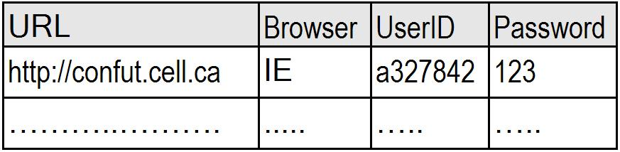
Test automation approaches / frameworks:
Data Driven Approach – sample code
vTestEnvXls = "C:\Test\UTTestEnvironment.xls";
# Retrieve environment variables from a file:
ddt_open(vTestEnvXls);
vURL = ddt_val (vTestEnvXls, "URL");
vBrowser = ddt_val (vTestEnvXls, "Browser");
vUserID = ddt_val (vTestEnvXls, "UserID");
vPassword = ddt_val (vTestEnvXls, "Password");
ddt_close(vTestEnvXls);

Slide 33
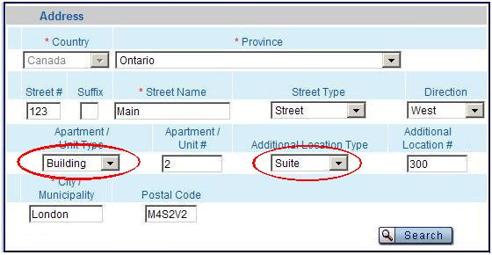
Test automation approaches / frameworks:
Data Driven Approach – an example
Service address validation:
Some “location types” were generating errors

Slide 34

Test automation approaches / frameworks:
Data Driven Approach – an example
44 location types
Ad hoc test automation
Script read all address fields from a data file
One script covered 44 functional test cases
Script was executed against several builds until this defect was completely fixed.
This script was also executed several times for regression testing.

Slide 35
Data Driven Approach – conclusion
We can use a “Data Driven” approach when:
  The workflow is identical and
  There are several different sets of test data for the same test procedure (workflow)
Benefits of a “Data Driven” approach:
  1 script automates several test cases and
  Test data can be prepared/verified by a functional tester or a Business Analyst.
  (everybody can use EXCEL without a training!)
Pros:
  High Efficiency

Slide 36
Combination of the functional decomposition and data driven approaches
This is a combination of two previous approaches:
  Script is broken into functions and
  Test data are being retrieved from a data file
This is the current industry standard
Most successful GUI test automation teams use this approach
Pros:
  High Maintainability
  High Efficiency

Slide 37
Keyword driven frameworks
First generation:
Action Words Driven Testing by Hans Buwalda
Keyword Driven Test Automation by Carl J. Nagle
Totally Data-Driven Automated Testing by Keith Zambelich
Second generation:
LogiGear TestArchitect (Hans Buwalda )
Worksoft's Certify (Linda Hayes)
Mercury Business Process Testing
Third generation:
The future of the keyword driven framework

Slide 38
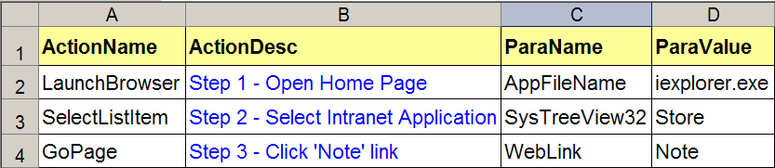
Keywords driven framework
1st generation
An EXCEL file represents the script:
Script is broken into functions.
Every “ActionName” has a corresponding function.
So called “Driver script” reads this table and invokes corresponding functions to execute different “Actions”.
You can’t use the inefficient “Record and replay” approach with a keyword driven framework.
Pros: High Maintainability
(due to enforced functional decomposition).

Slide 39
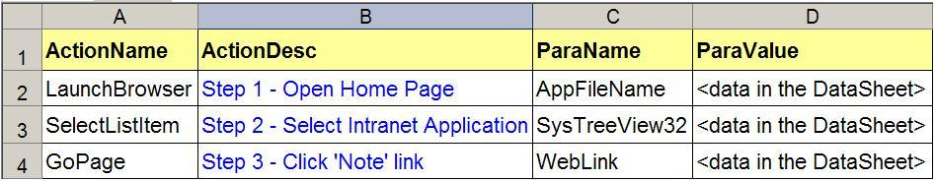
Keyword driven framework
1st generation – data driving
You can read data from an external data file.
(separate script files and test data files):
Pros: High efficiency
(one script can execute several sets of test data)
With keyword driven framework you use the same principles of functional decomposition (modularity) and separation of a script and data (data driving) to reach high maintainability and high efficiency.

Slide 40
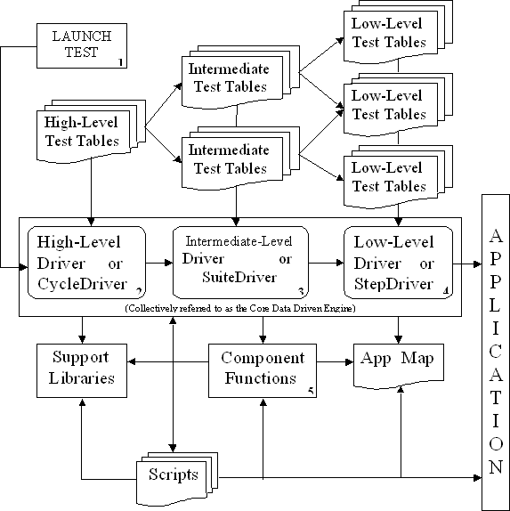
Keyword driven approach (Carl J. Nagle)
A complex hierarchy of “Driver scripts” is required to interpret and execute these test scripts.
Control of execution of a set of test scripts.

Slide 41
Keyword driven framework
1st generation – Business Analysts
Premise of a keyword driven framework:
  A Business Analyst or a Functional Tester can be used for test automation
  (they do not need to master a complex GUI test tool).
Reality:
  Good Business Analysts and Functional Testers are typically in short supply.
  Their main goal is to test the Application
  (develop new test cases)
  Using them for test automation is a waste of their time.

Slide 42
Keyword-driven frameworks presentations
I read many papers on these test automation tools/frameworks and attended several presentations.
Every time there was a comparison of a “new” wonderful sexy framework against a straw man of the infamous “record and replay” approach!
The conclusion was that this “new” framework provided undisputed benefits compared to the “classical” test automation approach.
At the same time these people were not enthusiastic to compare the action words driven or keyword driven framework against the de facto standard of GUI test automation: a combination of the data driven approach and functional decomposition.
Actually I never heard/saw a comparison of these two approaches by promoters of keyword-driven frameworks/tools.
Several times during these presentations I asked to compare these two approaches.
Every time my questions were disregarded!

Slide 43
1st generation of a keyword driven framework conclusion
Pros:
High Maintainability and maybe High Efficiency
It’s cool! You feel good implementing such complex framework ☺.
Respect. Managers do not understand what you are doing. So they respect your skills ☺.
Job security. Nobody can maintain this framework after you. Managers are at your mercy ☺.
Cons:
Complexity
Extra overhead
Not so user friendly (IDE is missing!)

Slide 44
2nd generation of a keyword driven framework
Worksoft's Certify (Linda Hayes)
LogiGear TestArchitect (Hans Buwalda )
Mercury Business Process Testing
The same paradigm as in 1st generation applies
(script is presented as a table)
Integrated Development Environment (IDE) is introduced

Slide 45
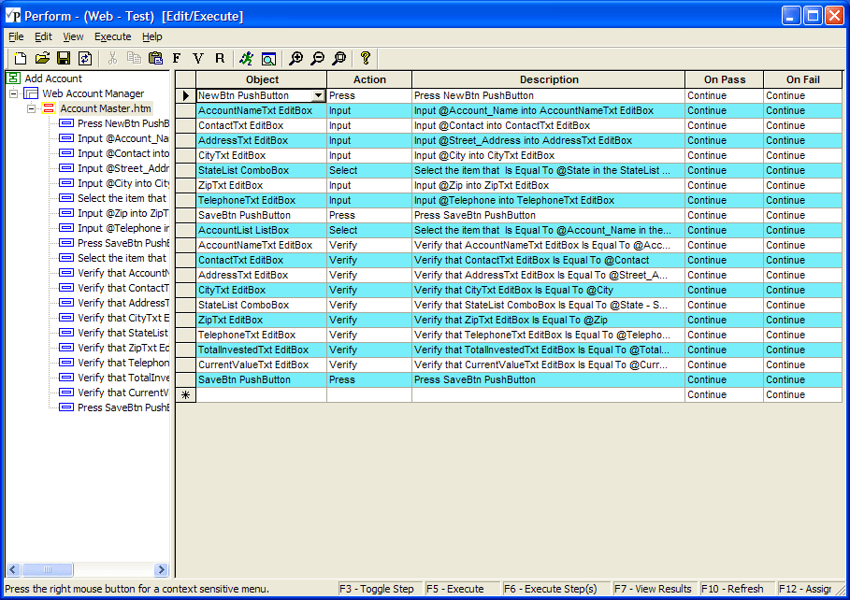
Story of a real life software project

Slide 46
2nd generation of a keyword driven framework conclusion
Pros:
More user friendly than a 1st generation
(Integrated Development Environment vs. EXCEL)
Cons:
It’s still more complex
Wrong premise of a Business Analyst used for test automation
When to use keyword driven frameworks:
When you have a surplus of good Business Analysts (application experts) you do not need for functional testing ☺.

Slide 47
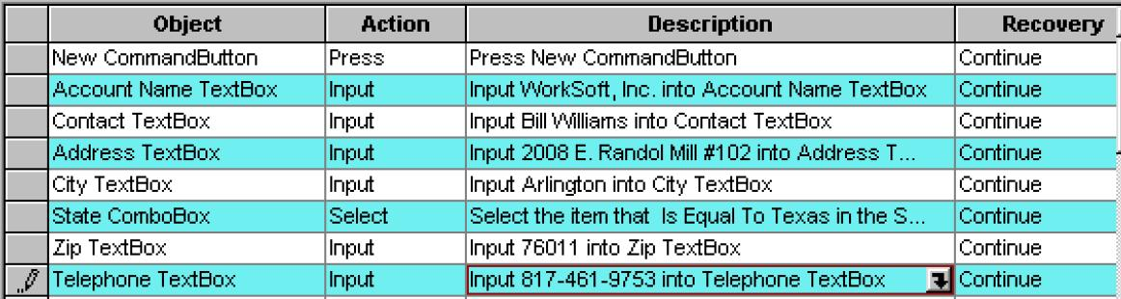
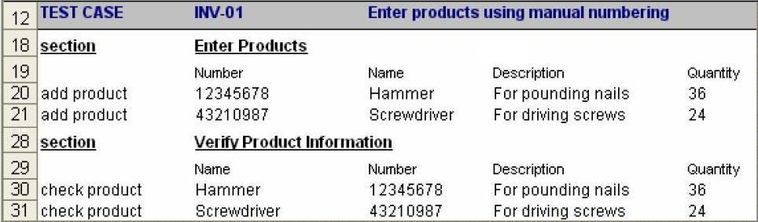
Keyword driven framework
Linda Hayes vs. Hans Buwalda
Worksoft Cerify (Linda Hayes):
LogiGear TestArchitect (Hans Buwalda):

Slide 48
Other alternatives – FIT/FITnesse
FIT/FITnesse framework:
  Developed in Java, C#, Perl, …
  No recording capabilities
  Wiki (a collaborative tool) is used:
    To develop test scripts (manually)
    To report test results
    To post other comments
The FIT/FITnesse framework is typically used by agile development teams

Slide 49
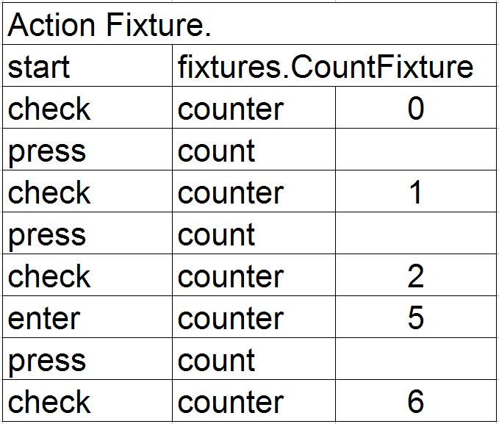
FITnesse – sample script
Sample FITness test script:
It looks like a keyword driven framework!

Slide 50
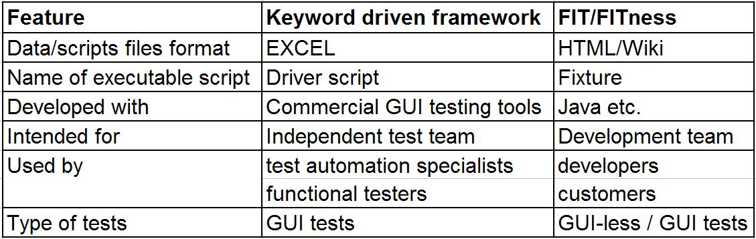
Keyword driven framework vs. FIT/FITnesse
Keyword driven framework vs. FIT/FITness:
FIT/FITness is just a variation of the keyword driven framework!
Designed to be used in an agile environment
(no place for an independent testing team)
Developers can use the same language to develop an Application and test “fixtures”!

Slide 51
FIT/FITnesse - recommendations
We can use FIT/FITnesse in:
  An Agile environment, when developers are working directly with customers.
Pros (when using FITnesse in an Agile environment):
  FITnesse Wiki is used to achieve two goals simultaneously:
    To document requirements and
    To develop test cases
    (Requirements = test cases in this case!)
  Developers can use the same language to develop applications and test “fixtures”.

Slide 52
3rd generation of keyword driven framework conclusion
Near future of keyword driven framework:
More user friendly
(fully functional modern IDE)
Better test management
(flexible scheduling and execution of tests)
Better test reporting
(including coverage of data-driven tests)
Better configuration management/version control
The next generation of keyword driven framework may be able to address the deficiencies of existing frameworks/tools.

Slide 53
Test Automation Process
5 – Main Principles of
Efficient Test Automation

Slide 54
First rule of GUI test automation
Probably you have already heard many times the first rule of GUI test automation:
It makes sense to automate a test case
when it will be executed about 10 times
(against 10 builds/releases of an Application).
This is a simplified rule.
It’s a good starting point for test planning.
Software development shop with daily/weekly builds vs. customized implementation of a commercial product.

Slide 55
“Good enough” test automation scripts
We can not justify the same quality requirements for a GUI test automation script (which will be executed only 10 times) as for an application which sells in the millions of copies
We can tolerate more bugs in test automation scripts than in mass market software products
How would we possibly test an automated test script?
The failure of a “good enough” test automation script doesn’t necessarily mean that a defect of an Application Under Test is discovered
Often a script fails because of a defect in the test script itself or in a test data set
Notes:
How many times can/should we execute this script for debugging purposes??
How can we verify error handling for this script?
We can’t reproduce all error conditions because we need to have different application errors to do this!

Slide 56
De facto standard of test case documentation
Sample functional test script:
  Click on “User ID” field
  Type in “a327012”
  Click on “Password” field
  Type in “12345”
  – 5 stars “*****” should be displayed
  in the “Password” field
  Click on “Login” button
  – main application screen should be displayed.
  Test procedure mixed with test data!

Slide 57
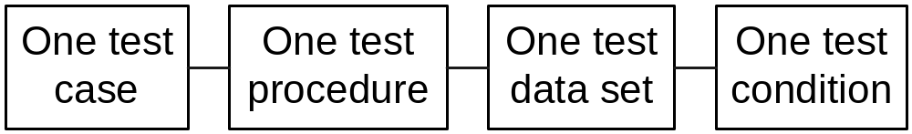
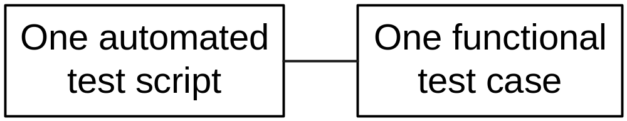
Current status of test documentation may lead to inefficient test automation
There is a de facto standard of test documentation which incorporates a test procedure and test data in one so-called “test case”:
Such functional test documentation may lead to inefficient test automation:
It’s not a fault of the “IEEE 829-1983 Standard for Software Test Documentation”.

Slide 58
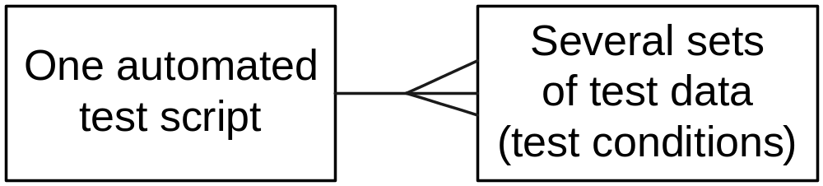
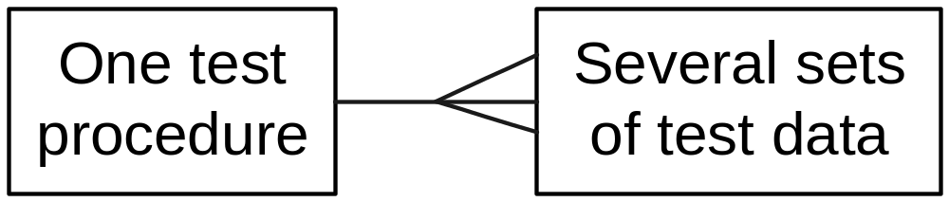
More efficient test automation
It is more efficient to cover several test conditions with the same automated test script:
To use this approach, we need the functional test documentation in the following format:

Slide 59
Efficient test automation starts with efficient test documentation
To ensure efficient GUI test automation you have two options:
  Convince your functional test team to use a better approach to test documentation or
  Convert the available set of functional test cases (yourself) into the following format:

Slide 60
Commercial test management tools and their integration with GUI test automation
Pros:
  Provide better “control” and an audit trail
  for test execution, coverage, etc.
Cons:
  Less portable and less maintainable scripts.
  A lot of network traffic.
  Typically these tools tend to produce very granular test cases like:
    Click on a field “…”
    Type in “…”
    Click on “Save” button
Hard to integrate with data driven framework.
A type of test documentation that leads to Inefficient test automation!

Slide 61
Myth #2 – The Test Automation Process is simple
A tools sales person will try to convince you that the following is a real GUI test automation process:
  Record a script.
  Enhance a script (add functions and/or data driving)
  Execute scripts
  Report defects
This process looks pretty simple and straightforward.
This simple process is just a myth!

Slide 62
Test Automation Process – reality
Real test automation process:
  Choose a test automation approach and develop a test automation framework
  Record a script.
  Enhance a script (add functions and/or data driving)
  Execute scripts
  Report defects

Slide 63
Test Automation Process – reality
Real test automation process:
  Choose a test automation approach and develop a test automation framework
  Design test automation scripts
  (efficient, maintainable, portable, etc.)
  Record a script.
  Enhance a script (add functions and/or data driving)
  Execute scripts
  Report defects

Slide 64
Test Automation Process – reality
Real test automation process:
  Choose a test automation approach and develop a test automation framework
  Design test automation scripts
  (efficient, maintainable, portable, etc.)
  Record a script.
  Enhance a script (add functions and/or data driving)
  Execute scripts
  Analyze causes of scripts’ failures
  Report defects

Slide 65
Test Automation Process – reality
Real test automation process:
  Choose a test automation approach and develop a test automation framework
  Design test automation scripts
  (efficient, maintainable, portable, etc.)
  Record a script.
  Enhance a script (add functions and/or data driving)
  Execute scripts
  Analyze causes of scripts’ failures
  Report defects
  Repair failed scripts

Slide 66
Myth #3 – GUI testing tools are simple -
Every functional tester can use them
This myth is promoted by the tool sales people.
This myth assumes the “click, click, click”, record and replay approach.
Under the influence of this myth a test manager proudly can report:
  “All our testers are using GUI test automation tools”.
Indeed:
  You do not need a developer’s skills to develop a simple test automated script with a “click, click, click”, record and replay approach.
But, this simplicity is just a myth!

Slide 67
Real Test Automation Process
Real test automation process:
  Choose a test automation approach and develop a test automation framework
  Design test automation scripts
  (efficient, maintainable, portable, etc.)
  Record a script.
  Enhance a script (add functions and/or data driving)
  Execute scripts
  Analyze causes of scripts’ failures
  Report defects
  Repair failed scripts

Slide 68
Reality – a programming background is required to use GUI testing tools
The efficient implementation of GUI testing tools typically requires functional decomposition + data driving approach.
You need to have some kind of a programming background to implement this approach.
GUI test automation scripts are not as complex as a classical C/C++ or Java back-end development.
Definitely, an experienced software developer or a Computer Science university graduate would make a good test automation specialist.
At the same time a science or engineering education would be more than adequate for GUI test automation.

Slide 69
Managing GUI Test Automation
6 – Managing GUI Test Automation

Slide 70
Managing GUI test automation - Test Planning
For GUI test automation, we must define:
The version of the Application Under Test to develop test scripts with
The target version of the Application Under Test for script execution / maintenance
The test environment to develop/execute automated test scripts
A set of regression test cases to automate
Test data (User IDs, accounts, invoices, etc.)
When to start (GUI should be stable enough)

Slide 71
Managing expectations – educate your managers
Reality vs. ‘Click, click, click” approach
Higher managers typically believe in the simplistic “Click, click, click” approach that does not include some phases of the real test automation process.
You have to educate them and explain real phases and real tasks that are being implemented.

Slide 72
Phases of a GUI test automation project
At the beginning of a GUI test automation project:
  Tool selection / Proof of Concept
  (Integrated vs. standalone? Can this tool drive your GUI?)
  Development of a basic framework
For each version/release:
  Design of test automation scripts
  (efficient, maintainable, portable, etc.)
  Development (and debugging) of automated test scripts
For each build:
  Execution of automated scripts / analysis of results / reporting of anomalies/defects
  Maintenance of automated scripts - fixing of defects in scripts or test data.
Assign all phases of a test automation process to the same person / team!

Slide 73
Cooperation with functional testers
The most important success factor is good cooperation with functional testers.
Typically, test cases are documented with the assumption of enough knowledge of the Application Under Test.
Test automation folks need a lot of help from functional testers to understand functional test documentation.
When functional testers understand that the goal of GUI test automation is to help them test, and when they see real results of test automation they become interested in the success of test automation and are willing to provide enough support.

Slide 74
Cooperation with functional testers – an example
Functional testers:
“Here is a list of functional test cases I am bored to death with executing. Can you automate these test cases?”
Test automation specialist:
“I can automate these test cases easily.”
“These test cases would require several times more effort from me to automate.”
“These test cases are rather complex and time consuming to automate. I doubt I will be able to do this in the allotted time.”
“Look! In addition I can also automate some more test cases. It will take very little of my time and will be almost free for you!”
The role of a manager is to make the final selection after considering all trade-offs.

Slide 75
Work with your developers
Educate your developers about importance of:
  Stable GUI
  Testable GUI
  Testable non-GUI interfaces

Slide 76
Test environment and test data
Pay attention to the test environment and test data during the whole process from development of test scripts to execution against consecutive versions/builds of an Application to be tested.
In a simplified case you will be able to use the same test environment and the same set of test data for the whole test development and test execution process.
Otherwise you have to understand how these scripts will be executed against another test environment when:
  The old set of User IDs/passwords is no longer available,
  Old business data (account numbers, invoice numbers, etc.) are no longer available.

Slide 77
Test automation metrics – script development
How can we track progress of test automation?
During the development of automated test scripts use The number of functional test cases which were automated as a metric.
This would lead to the implementation of efficient automated scripts.
Do not use the number of developed test automation scripts as a criteria of progress.
This would lead to development of zillions of small simple inefficient automated test scripts.

Slide 78
Test automation metrics – scripts development
Let’s assume that you have 27 scripts.
You need to execute them against different environments (e.g. QA, Mirror, Staging) using different browser and user IDs.
What would you do with a “classical” record and replay approach?
You develop a script for every combination of a target URL, e.g.:
  Verify_Access_QA,
  Verify_Access_Staging,
  Verify_Access_Mirror
  The only difference between scripts – initial URL!

Slide 79
Test automation metrics – script execution
During the phase of execution of automated test scripts consider using the following metric:
The duration of execution of all test scripts since the moment new build become available until all results are analysed and anomalies/defects are reported.
An example:
  Build became available at 2:00 AM.
  Testers started execution of automated test scripts at 9:00 AM.
  Test execution was completed at 12:00 AM.
  Results were analyzed and anomalies/defects were reported by 2:00 PM.
  In this example test execution took 12 hours
  from 2:00 AM when new build became available
  until 2:00 PM when all discovered anomalies were reported.

Slide 80
An ideal case of GUI test automation
When functional testers arrive at 9:00 AM they should have anomalies discovered by automated scripts already reported to them!
How we can reach this goal:
  Start the execution of a set of automated test cases immediately after a build process was successfully finished, Application was deployed and restarted. This could be done by:
    A build manager starting execution of automated test cases manually.
    Integration of an automated build process and test execution.
  Test automation team can start analysis of results of test execution one or two hours before the start of the work day of a functional test team.
  Use a set of additional workstations and test tool licenses specifically for test execution.
  Each test automation specialist should have at least two workstations and two GUI testing tool licenses.

Slide 81
GUI Test Automation - Summary
GUI test automation tools and frameworks are evolving
The following is the current industry standard for GUI test automation, which ensures more efficient test automation and a better ROI:
  Mainstream GUI test automation tools (Mercury WinRunner and QuickTest Pro, Segue Silk, Compuware QARun, Rational Robot, etc.)
  A test automation framework which uses a combination of “Functional decomposition” and “Data driving” approaches.
Pros:
  High Maintainability
  High Efficiency

Slide 82
Offshore GUI Test Automation
7 – A case study of offshore
GUI Test Automation

Slide 83
Challenges of offshore outsourcing of GUI Test Automation - 1
Management issues:
  Management of a team working with 11 hour time shift.
  Typically status conference calls were scheduled
  for 8:00 AM EST (7:00 PM offshore time)
  or 9:00 PM EST (7:00 AM offshore time).
  It was impossible to resolve any issue at the middle of a work day.
  It was hard to asses the qualification of team members over the phone etc.
  It happened that not all members of this team were equally qualified to do the job.
  Arising issues were not escalated early enough.
  Status reporting was improved when direct and specific metrics were introduced.
  Messages like “80% finished” or “Everything is OK” often were not accurate.

Slide 84
Challenges of offshore outsourcing of GUI Test Automation - 2
An interaction between functional testers and a test automation team.
  The turnaround for all questions about functional scripts was one work day:
    Question – today
    Answer – tomorrow
  Typically questions and answers were in writing; this required more time.
  A person was specifically assigned to provide this type of support – it was his main job
  (answering e-mails with questions).

Slide 85
Challenges of offshore outsourcing of GUI Test Automation - 3
Support of test environment/application (at night)
  The test automation team was losing a complete work day when the Application was not available in a test environment because of:
    Application being down
    User IDs/passwords having been changed
    Wrong version of a code of the Application Under Test having been deployed
    etc.

Slide 86
Challenges of offshore outsourcing of GUI Test Automation - 4
Network connectivity:
  Getting an approval for SecurID tokens for an offshore team/shipping.
  Responsiveness of a GUI test tool during script development was very slow because
    an integrated test approach was used and scripts were stored in a test management tool.
    Network (through a VPN) between the offshore location and the test management tool was chocking scripts development.

Slide 87
Offshore outsourcing of GUI test automation – recommendations
Do not hesitate to outsource GUI test automation when you already outsource:
  Functional testing
  Test environment / Test environment support
When you outsource only GUI test automation:
  Be prepared to spend much more time managing an offshore test automation project.
  Assess how detailed your documentation of functional scripts is, and plan/budget for functional support of the GUI test automation team by one of your functional testers / BA’s.
  Ensure that you have adequate support for your test environment (e.g. 7/24 pager support)
  Ensure that your network is adequate for the demand of your tool / framework.

Slide 88
Offshore outsourcing of GUI test automation – conclusion
This can be done.
Risk of failure is significantly higher.
Be careful and be prepared.

Slide 89
Appendices
Appendices

Slide 90
Recommended reading & References
8 – Recommended reading & References

Slide 91
Further reading - 1
You can find a lot of useful information on GUI test automation on the vendors’ sites:
  Mercury Interactive:
  http://www.mercury.com
  Segue:
  http://www.segue.com/
  Compuware:
  http://www.compuware.com/
  IBM / Rational:
  http://www-306.ibm.com/software/rational/

Slide 92
Further reading - 2
Keyword driven frameworks:
  “Action words driven testing” by Hans Buwalda: www.sqe.com/archive/stacf2001/TestAutomation.pdf
  “Keyword Driven Test Automation” by Carl J. Nagle: safsdev.sourceforge.net/ DataDrivenTestAutomationFrameworks.htm
  “Totally Data-Driven Automated Testing” by Keith Zambelich:
  www.sqa-test.com/w_paper1.html
  “Certify” by Linda Hayes:
  http://www.worksoft.com/

Slide 93
Further reading - 3
Ruby main web site http://rubyforge.org/
"Programming Ruby" http://www.rubycentral.com/book/
WATIR main web site: http://wtr.rubyforge.org/
mailing list: http://rubyforge.org/mailman/listinfo/wtr-general
Foundations of computer programming
(for people without computer background):
  “Structure and Interpretation of Computer Programs”,
  by H. Abelson and G. J. Sussman:
  http://mitpress.mit.edu/sicp/full-text/book/book.html
  Software Design, Greg Wilson, UofT:
  http://test.kmdi.utoronto.ca/cosmin/website_archived.aspx?dir=1

Slide 94
References - 1
The following sources were used for this workshop:
  A diagram of a keyword driven framework from “Test Automation Frameworks” by Carl J. Nagle :
  http://safsdev.sourceforge.net/ DataDrivenTestAutomationFrameworks.htm
  A screenshot of Certify from: http://www.worksoft.com/
  A sample Visual Test script from
  "Building an Automation Framework with Rational Visual Test“ by Thomas Arnold:
  http://www.automationjunkies.com/resources/article_build_auto_frame.shtml

Slide 95
References - 2
The following sources were used for this workshop:
  A sample Worksoft's Certify test script from
  “Test Automation and WorkSoft Certify”,
  Linda G. Hayes
  A sample LogiGear TestArchitect test script from “Achieving the Full Potential of Test Automation”, LogiGear Corporation 2006

Slide 96
References - 3
The following sources were used for this workshop:
  Sample Perl code from
  "Automated GUI Testing “ by George Nistorica:
  http://www.perl.com/pub/a/2005/08/11/win32guitest.html?page=1
  A sample WinRunner keyword driven script by Larry Liu (CGI CTQ)
  A sample FITness script from: http://www.fitnesse.org/FitNesse.ActionFixture

Slide 97
Contact information
Yury Makedonov,
IVM-S
(416) 481-8685
yury@ivm-s.com
http://www.ivm-s.com

